Slide 1
Air Quality Analysis of Indian Cities (2020–2023)
A Data-Driven Study on Pollution Trends and Insights

Slide 2
Project Objective
Analyze air quality trends of Indian cities using AQI data from 2020 to 2023
Identify the most polluted cities across these years
Visualize patterns and changes in AQI levels using data analytics tools
Derive meaningful insights for urban environmental awareness and action

Slide 3

AQI (Air Quality Index)
The AQI (Air Quality Index) is a measure used to communicate how polluted the air currently is or how polluted it is forecast to become. It's especially useful for public health awareness.
Major Pollutants Tracked in AQI:
PM2.5 (fine particles)
PM10 (coarse particles)
NO₂ (Nitrogen Dioxide)
SO₂ (Sulphur Dioxide)
CO (Carbon Monoxide)
O₃ (Ozone)
NH₃ (Ammonia)

Slide 4
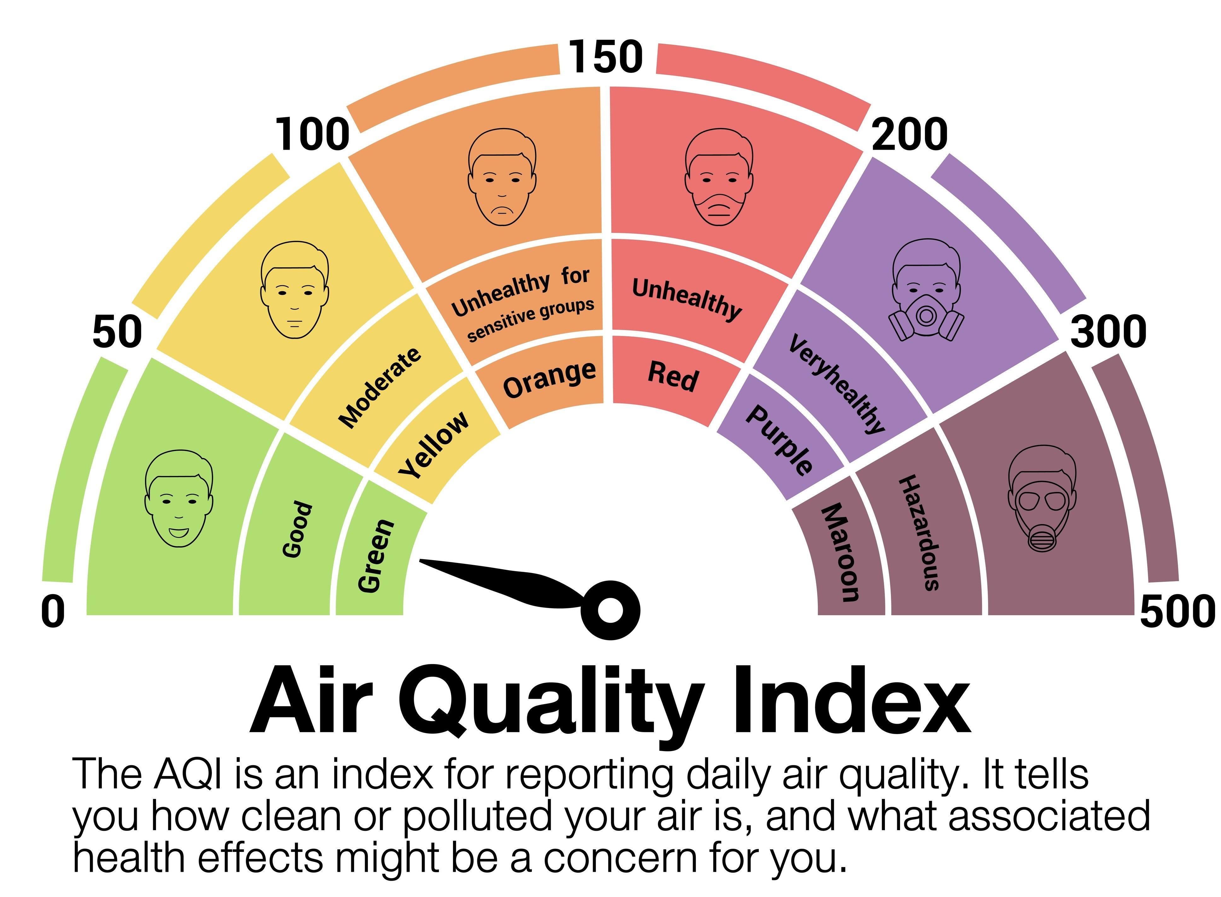
Importance of AQI
To monitor and analyze air pollution across Indian cities (2020–2025).
AQI measures the level of air pollution using key pollutants.
Supports decision-making for environmental health and policy.
Highlights major pollution sources like PM2.5, CO, and O₃.

Slide 5
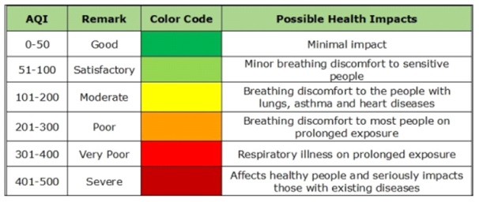
AQI Levels and Health Impacts
The Air Quality Index (AQI) categorizes air pollution levels from Good to Severe, using a color-coded system. As AQI increases, the air becomes more harmful, causing health discomfort and serious illnesses, especially in sensitive groups. Monitoring AQI helps in taking timely actions to protect public health.

Slide 6
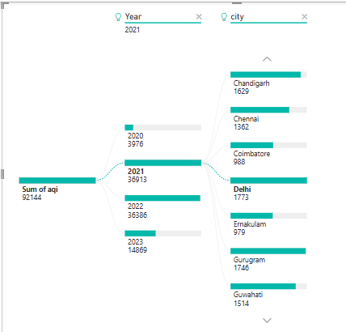
Dataset Summary
Source: air_pollution_dta.csv
Time Frame: 2020 to 2023
Key Features:
City
Year
Air Quality Index (AQI)
Key Pollutants: PM2.5, PM10, NO₂, SO₂, CO, O₃, NH₃
Data cleaning and preparation performed using Python (Pandas, matplotlib, seaborn) and dashboard is created by Power BI.

Slide 7
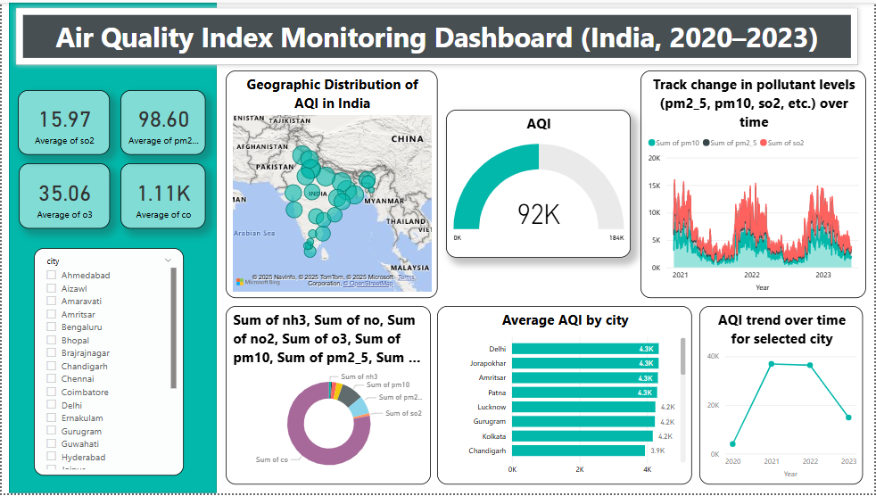

Slide 8
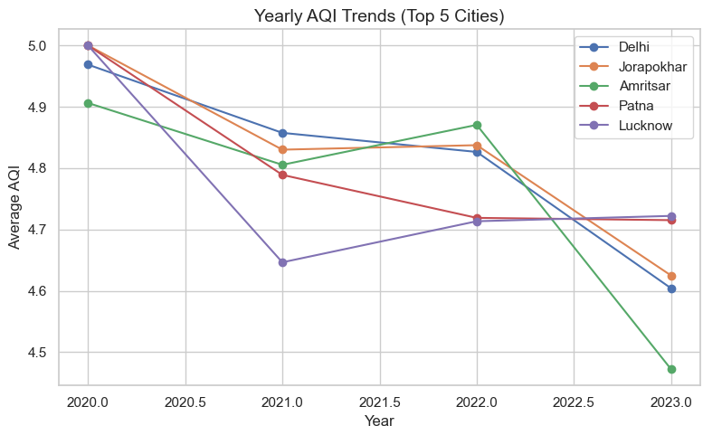
Dashboard Overview
Developed using Microsoft Power BI.
Includes geographic AQI map, pollutant trends, and city comparisons.
Visualizes total emissions of key pollutants.
Tracks AQI changes over time and by region.

Slide 9
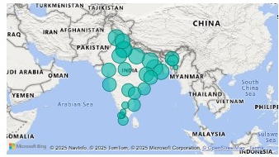
Geographic Distribution of AQI in India
This map visualizes the average Air Quality Index (AQI) across various Indian cities using data from the air_pollution_dta.csv dataset (2020–2023). Each bubble represents a city, with the size indicating the relative level of air pollution.

Slide 10
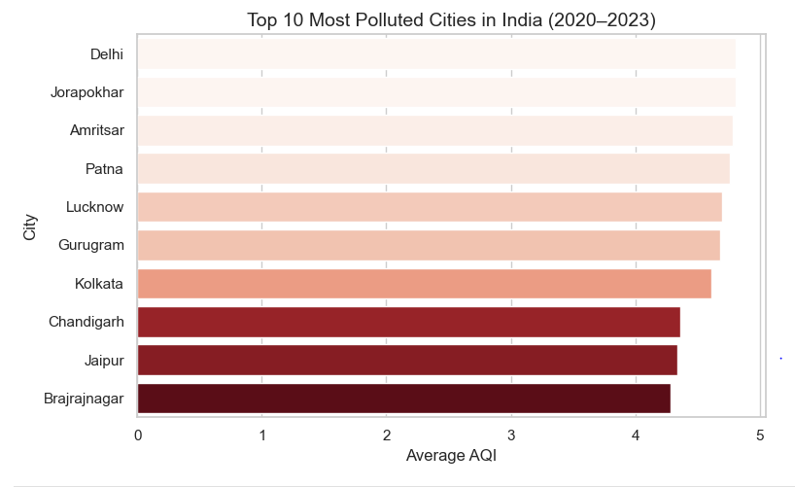
Top 10 Most Polluted Cities (2020–2023)
Bar chart shows average AQI for each city
Cities with the worst air quality:
Delhi, Jorapokhar, Amritsar, Patna, Lucknow, Gurugram, etc.
High AQI → Poor air quality and health risks

Slide 11

Social Impact Of The Project
Understanding the large impact of air pollution is crucial to public health. Poor air quality affects public health, causing issues like headaches, fatigue, respiratory diseases, and increased risk of infections. Improving AQI can lead to better health outcomes, reduced disease burden, and a healthier environment for both people and wildlife.

Slide 12
Challenges & Limitations
Data Gaps
Incomplete or inconsistent AQI data across regions and time periods.
Public Awareness
Low awareness and engagement from the public on air quality issues.
Technological Constraints
Limited access to real-time and high-resolution data tools.
Limited Monitoring Stations
Rural and remote areas often lack air quality sensors.

Slide 13
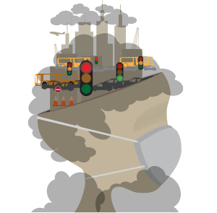
Conclusion & Recommendations
High AQI regions need immediate attention (Delhi, Patna, Lucknow).
Enhance real-time AQI tracking systems
Introduce more green belts, reduce vehicle emissions.
Encourage public awareness and community-based pollution control.

Slide 14
Thank you

